Slide 1



Communicating and Visual Design with Color
IMD316 | WEEK 5
MOHD AKMAL FAIZ OSMAN

Slide 2
COURSE OUTLINE
Understanding Color
Using Color Tables and Options
Using Type of Fonts
Differentiate Print and Web Colors
Visual Design
1

Slide 3
Understanding Colors
The tools we use to describe color are different when the color is printed than from when it is projected.
Projected color is additive.
Printed color is subtractive.

Slide 4
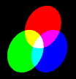
Additive Color
The additive reproduction process usually uses red, green and blue light to produce the other colors.
No light (or color) is black. All light (all colors) is white.

Slide 5

Subtractive Color
Subtractive color explains the theory of mixing paints, dyes, inks, and natural colorants to create colors which absorb some wavelengths of light and reflect others.

Slide 6
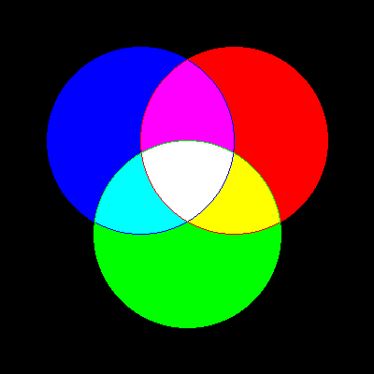
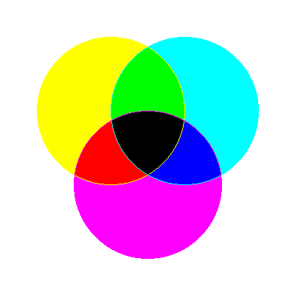
4.2 Colors
Color models:
Different ways of representing information about color
Example:
RGB
HSB
CMYK

Slide 7
HSB Model
Based on human perception of color, describe three fundamental properties of color:
Hue
Saturation (or chroma)
Brightness - relative lightness or darkness of color, also measured as %
* There is no HSB mode for creating or editing images

Slide 8
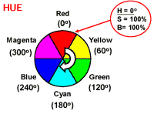
HSB Model
Hue - color reflected from or transmitted through an object, measured on color wheel

Slide 9
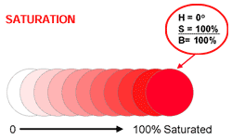
HSB Model
Saturation (or chroma) - strength or purity of color (% of grey in proportion to hue)

Slide 10
HSB Model
Brightness - relative lightness or darkness of color, also measured as %
0%
50%
100%
Black |  |  |  |  |  |  |  |  | white

Slide 11
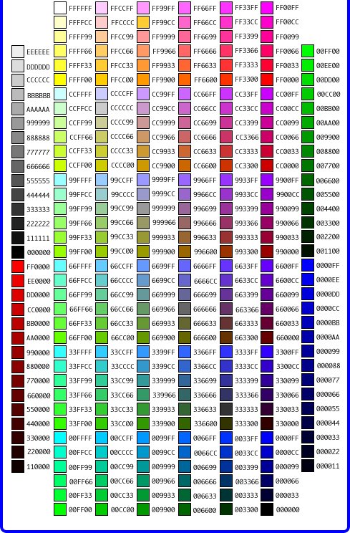
RGB Model
Add red, green and blue to create colors, so it is an additive model.
Assigns an intensity value to each pixel ranging from 0 (black) to 255 (white)
A bright red color might have R 246, G 20, B 50

Slide 12
CMYK Model
Based on light-absorbing quality of ink printed on paper
As light is absorbed, part of the spectrum is absorbed and part is reflected back to eyes
Associated with printing; called a subtractive model
Four channels: Cyan (C ), magenta (M), yellow (Y) and black (K)
In theory, pure colors should produce black, but printing inks contain impurities, so this combination produces muddy brown
K is needed to produce pure black, hence CMYK is four-color process printing

Slide 13
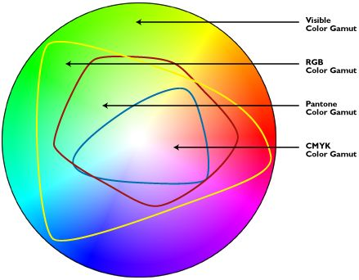
4.2 Color
Color Gamut
Range of colors that a color system can display or print
Different models have different gamut (RGB has the smallest gamut, approximately)

Slide 14
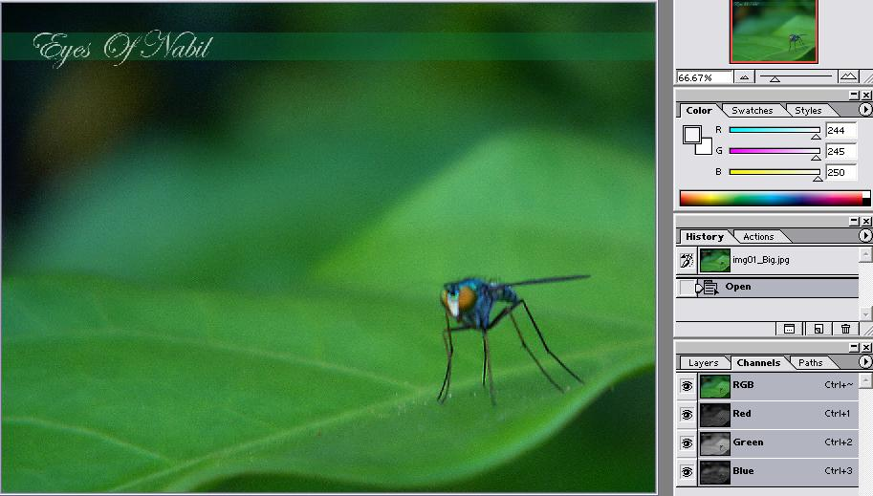
4.2 Color
Color Channel
Photoshop shows information about color elements in different channels
E.g., RGB has at least three channels; CMYK has at least four channels - at least, because Photoshop also permits “Alpha” channels for storing mask information
A mask lets part of an image be transparent so that other layers show through

Slide 15

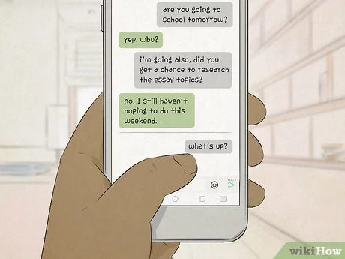
TEXT
Text

Slide 16


What is TEXT?
Basic media for many multimedia systems.
Texts in the form of words, sentences and paragraphs is used to communicate thoughts, ideas and facts in nearly every aspect of our lives.

Slide 17
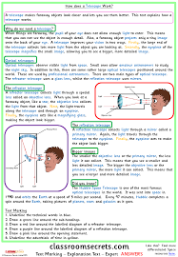
What is TEXT?
Multimedia products depends on text for many things:
to explain how the application work.
to guide the user in navigating through the application.
deliver the information for which the application was designed.

Slide 18
ISSUES with TEXT?
Minimize the texts in multimedia application
Texts consists of two structures:
Linear
Non-Linear

Slide 19
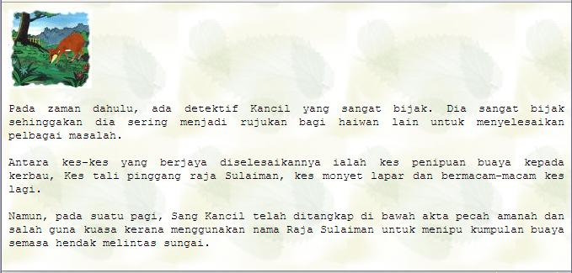
What is TEXT?
Linear
A single way to progress through the text, starting at the beginning and reading to the end.

Slide 20
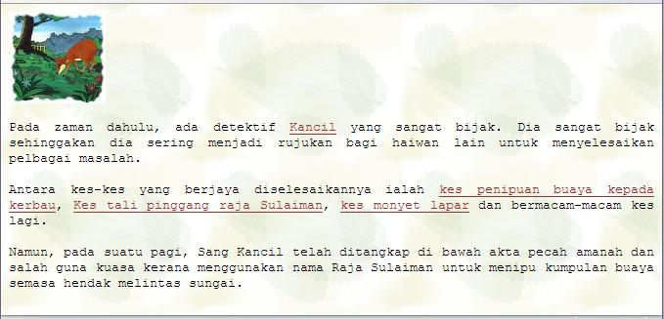
What is TEXT?
Non-Linear
Information is represented in a semantic network in which multiple related sections of the text are connected to each other
A user may then browse through the sections of the text, jumping from one text section to another.
Kancil Page
Belt Case Page
Hungry Monkey Page
Crocodile Case Page

Slide 21
Why Text is Important in MM?
Factors affecting legibility of text:
Size.
The size of the text
Background and foreground color
The color in which the text is written in / on.
Style
Also known as typeface and font
Leading
refers to the amount of added space between lines of type.
Originally, when type was set by hand for printing presses, printers placed slugs—strips of lead of various thicknesses—between lines of type to add space.

Slide 22
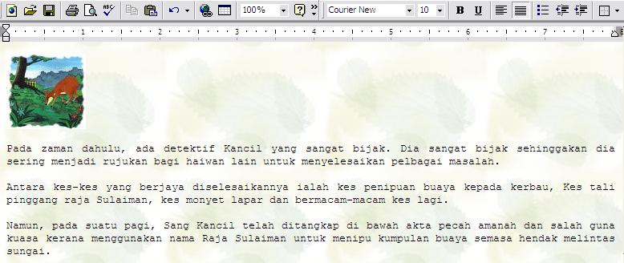
Why Text is Important in MM?
Factors affecting legibility of text:
Background and foreground color (BG – Light colored, FG – Dark)
Size.
Style
Leading

Slide 23
Text Technology
Based on creating letters, numbers and special characters.
Text elements can be categories into:
Alphabet characters : A – Z
Numbers : 0 – 9
Special characters : Punctuation [. , ; ‘ …] , Sign or Symbols [* & ^ % $ £ ! /\ ~ # @ .…]
Also known Character Sets

Slide 24
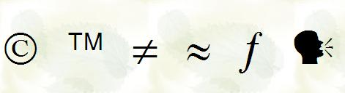
3.2 Text Technology
May also include special icon or drawing symbols, mathematical symbols, Greek Letter etc.

Slide 25
Font Effects
The technology of font effects in bringing viewer’s attention to content:
Case: UPPER and lower cased letter
Bold, Italic, Underline, ^{superscript} or _{subscript}
Embossed or Shadow
Colours
Strikethrough

Slide 26
Font Effects Example
MENU
The Story
The Prison
The Characters
The Further Adventures Of Sang Kancil
Kancil purposely let himself go to prison to save his cousin Pelanduk that has been wrongfully accused of murdering kura-kura using CO². Kancil forged the buaya crossings event and stealing the precious rambutan across the river in order to be sentenced to a life in prison.
The prison, a high security facility jungle prison located on no mans land is impossible to break into and a place for high profile criminals. Now that he is in, it’s up to his cunning skills and technical know how to find his cousin and help him to escape and prove his innocence.
CHAPTERS
1
2
3
4
5

Slide 27
Text Characteristic
This example shows the Times New Roman font
Ascender
an upstroke on a character
Capital Height
x-Height
FD xhp
Serif
p -Height
Descender
The down stroke below
the baseline of a character
Point size

Slide 28
Kerning of Text
Kerning
space between pairs of characters, usually as an overlap for improvement appearance
Tight
tracking
Loose
tracking
Av
A
v
Unkerned
Kerned

Slide 29
Leading of Text
Leading
spacing above and below a font or Line spacing
Reading Line One
Reading Line Two
Leading

Slide 30


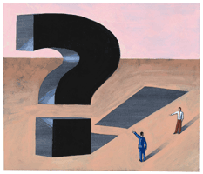
Types of Fonts
Two classes of fonts
Serif
Sans Serif

Slide 31
Serif Text
Decorative strokes added to the end of a letter's
Serifs improve readability by leading the eye along the line of type.
Serifs are the best suited for body text.
Serif faces are more difficult to read in small scale (smaller than 8pt) and in very large sizes.

Slide 32
San Serif Text
Sans serif faces doesn't have decorative strokes.
A sans serif text has to be read letter by letter.
Use sans serif faces for small (smaller than 8pt) and very large sizes.
Used for footnotes and headlines

Slide 33
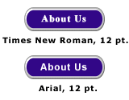
Serif vs Sans Serif Fonts
For computer displays, Sans Serif fonts considered better because of the sharper contrast.
Serif
San Serif

Slide 34
Types of Fonts: Examples
Examples of San Serif fonts
Times New Roman
Bookman
Rockwell Light
Courier New
Century
Century Gothic
Arial
Comic Sans MS
Impact
Tahoma
Examples of Serif fonts

Slide 35
Using Text in Multimedia
The text elements used in multimedia are:
Menus for navigation
Interactive buttons
Fields for reading
HTML documents
Symbols and icons

Slide 36
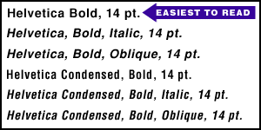
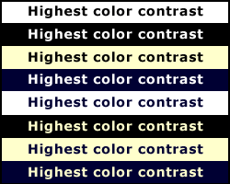
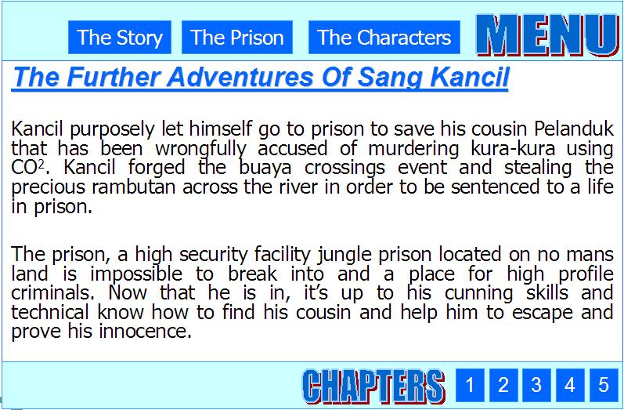
Using Text in Multimedia
Text applying guidelines:
Be concise
Use appropriate fonts
Make it readable
Consider type styles and colors
Use restraint and be consistent

Slide 37
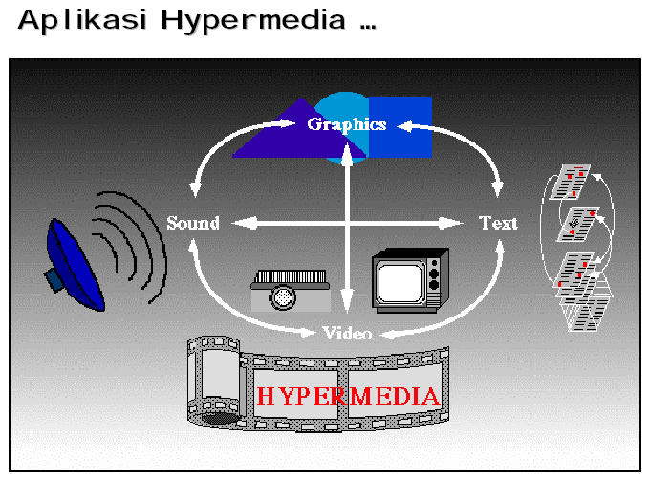
Text in Hypermedia

Slide 38
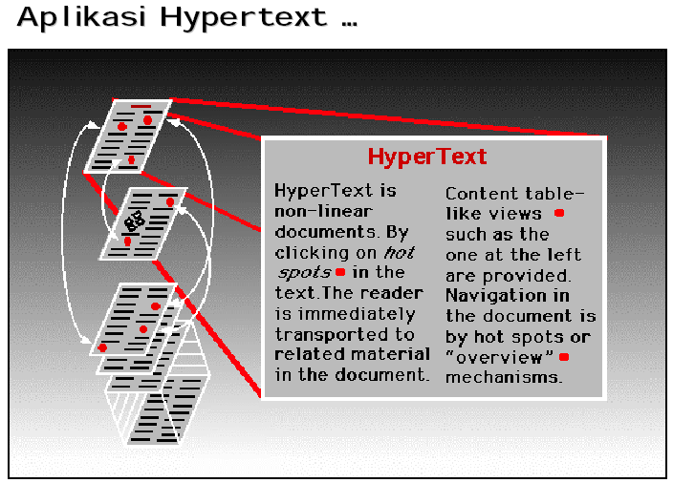
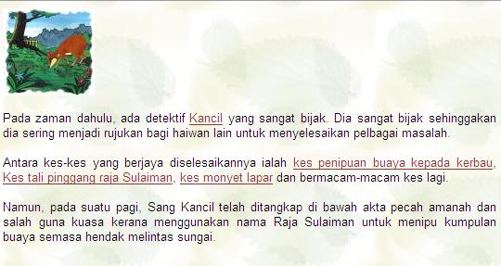
Hypertext

Slide 39
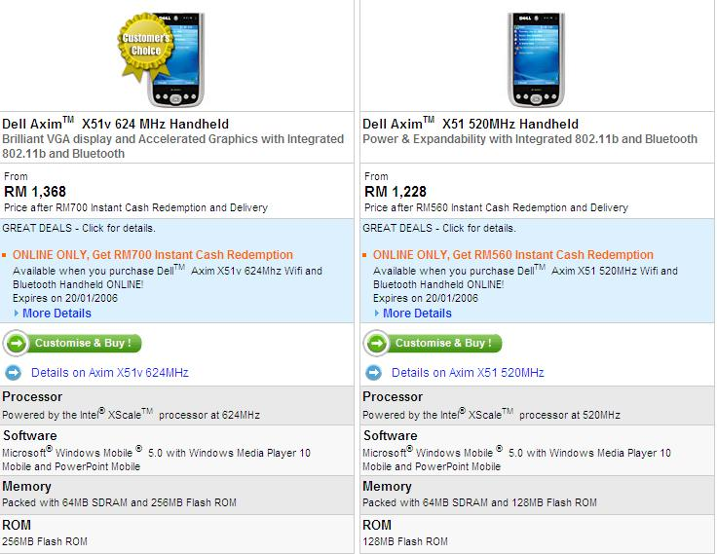
How Text Can Be Used Effectively
Communicating Data
Customer names and address
Pricing information of products

Slide 40
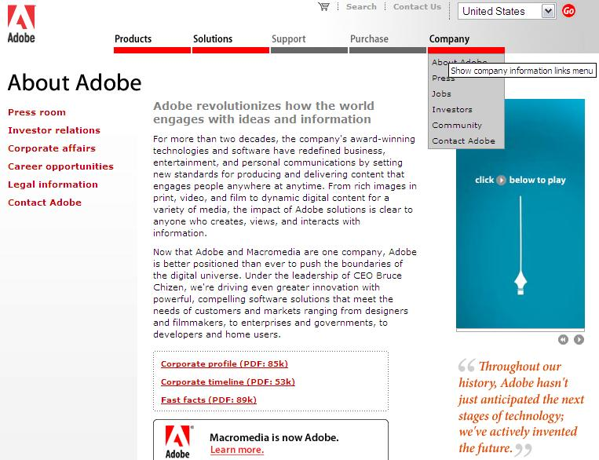
How Text Can Be Used Effectively
Explaining concepts and ideas
A company mission statement
A comparison of medical procedures

Slide 41
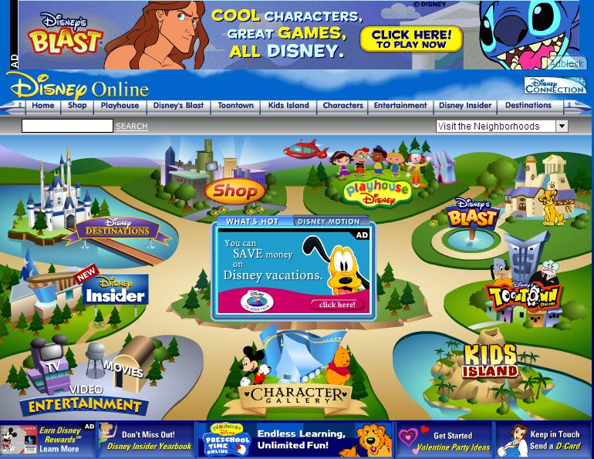
How Text Can Be Used Effectively
Clarifying other media
Labels on button, icons and screens
Captions and callouts for graphics

Slide 42

Advantages & Disadvantages Using Text
Advantages:
Is relatively inexpensive to produce
Present abstract ideas effectively
Clarifies other media
Provides confidentiality (password)
Is easily changed or updated

Slide 43

Advantages & Disadvantages Using Text
Disadvantages:
Is less memorable than other visual media
Requires more attention from the user than other media
Can be cumbersome – not elegant in expression

Slide 44
Summary
Multimedia applications and presentations invariably rely to some extent on the use of text to convey their message to users.
Text has many characteristics that the developer can modify to enhance the user expression.
size, weight, typeface, style, colour, kerning, tracking, etc.
Just like any other media, it requires careful planning and creativity.

Slide 45
The End of Chapter 5
akmalfaiz@uitm.edu.my
School of Information Science,
College of Computing, Informatics and Mathematics
Universiti Teknologi MARA (UiTM)

